Slide 1
Azure OVERVIEW
Sérgio Prates
Engenheiro de Software
Lambda3
Email: sergio.prates@lambda3.com.br
Twitter: @sergiopratess

Slide 2

Agenda
O que é o Azure?
O que é uma assinatura?
Permissões
Environments
Resource Groups
Templates ARM

Slide 3

O que é o Azure?
Uma solução de nuvem lançada em 1 de fevereiro de 2010 criada e mantida pela Microsoft.

Slide 4

Nuvem?

Slide 5
Entenda nuvem como:
Uma rede global de servidores
Operam em um ecosistema único
Armazena e gerencia dados
Executa aplicativos
Fornece conteúdos e serviços
Pode ser pública, privada ou híbrida

Slide 6

Organização
Entidade de negócios que utiliza as ofertas de nuvem da microsoft
Geralmente identificada por um ou mais nomes de domínio (lambda3.com.br é uma organização)
Cada organização é um container para diversas assinaturas

Slide 7

Assinaturas
Contrato com a Microsoft para utilização dos serviços
Cada organização pode ter várias assinaturas
Cada assinatura pode ter várias licenças (SaaS por exemplo)

Slide 8

Grupos de Recursos
Coleção lógica de serviços (web app, VM`s, banco de dados, etc)
Permite a separação dos recursos de forma que fica fácil identificar as depêndencias de cada aplicação
Permite controle de acesso por grupos
Facilita o gerenciamento de custos
Notes:
Entender o lifecycle
Armazenar no repositorio?
Separar subscriptions?

Slide 9

Azure AD
Contrato com a Microsoft para utilização dos serviços
Cada organização pode ter várias assinaturas
Cada assinatura pode ter várias licenças (SaaS por exemplo)

Slide 10

O que é o Azure?
Move Faster
Save Money
Hybrid Consistency
$

Slide 11
Global Footprint

Slide 12
pay only for what you use
→

Slide 13
no upfront costs

Slide 14

per minute billing

Slide 15
no charge for stopped VMs
$

Slide 16
Windows Azure

Slide 17

Virtual Machines
Windows Server and Linux Virtual Machines
Flexible Workload Support
Virtual Private Networking

Slide 18

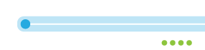

Load Balancing and High Availability
Availability Set
Load-Balanced Traffic (TCP/UDP)

Slide 19
Availability Sets + LBs

Slide 20
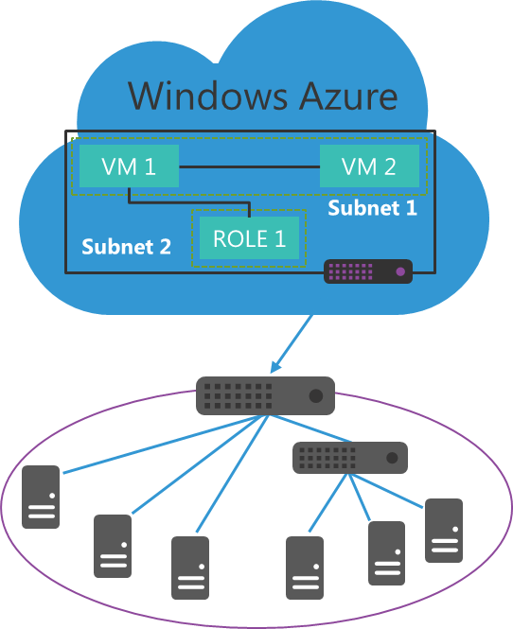
Windows Azure Virtual Networks
Build virtual networks that scale
Traditional, familiar approach to build extension to datacenter
Scalable approach to building virtual networks
Control over network configuration
Define your own IP address ranges
Be compliant with corporate IT security policy
Enables rich hybrid scenarios
Hybrid apps can reach all or portion of the on-premise network
Works with both Windows and non-Windows systems
Corpnet

Slide 21





Virtual Gateways
Contoso Production VNet in Windows Azure (10.1.0.0/16)
Point-to-Site
VPNs
Contoso HQ (10.0.0.0/16)
10.1.2.0/24
10.1.3.0/24
SQL Farm
IIS Servers
131.57.23.120
S2S VPN tunnel
65.52.249.22
10.1.0.4
10.1.1.4
10.0.0.10
10.0.0.11
Contoso Test in Windows Azure (10.2.0.0/16)
AD / DNS
S2S VPN Device
S2S VPN tunnel
Exchange
BRK Gateway
10.2.2.0/24
10.2.3.0/24
Point-to-Site
VPNs

Slide 22
Command Line
Automation

Slide 23
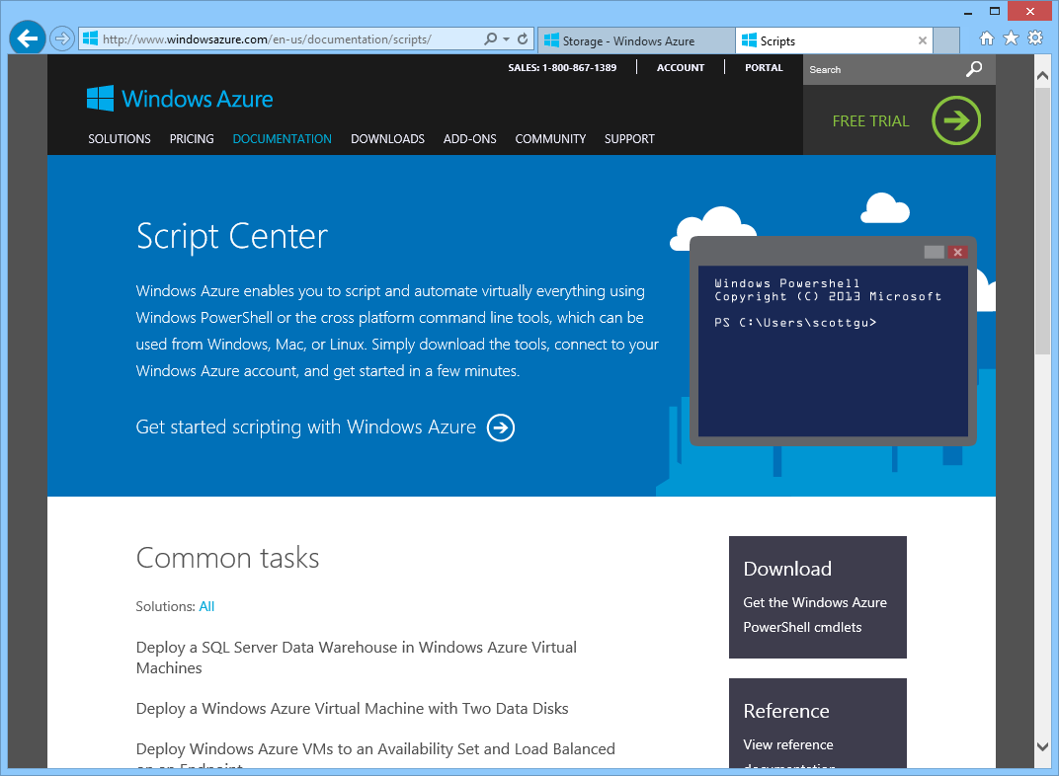

Slide 24
Dev/Test Scenarios

Slide 25
MSDN Member Benefits
No credit card needed for MSDN members to sign up
Discounted rates for Dev/test scenarios (up to 97% savings)
MSDN credits per month-use for any Dev/test scenario

Slide 26




MSDN Credits with Windows Azure
$50
per month
for Visual Studio Professional
$100
3 VMs for 16 hours a day
per month
for Visual Studio Premium
$150
per month
Up to 500 web sites plus SQL DB
for Visual Studio Ultimate

Slide 27
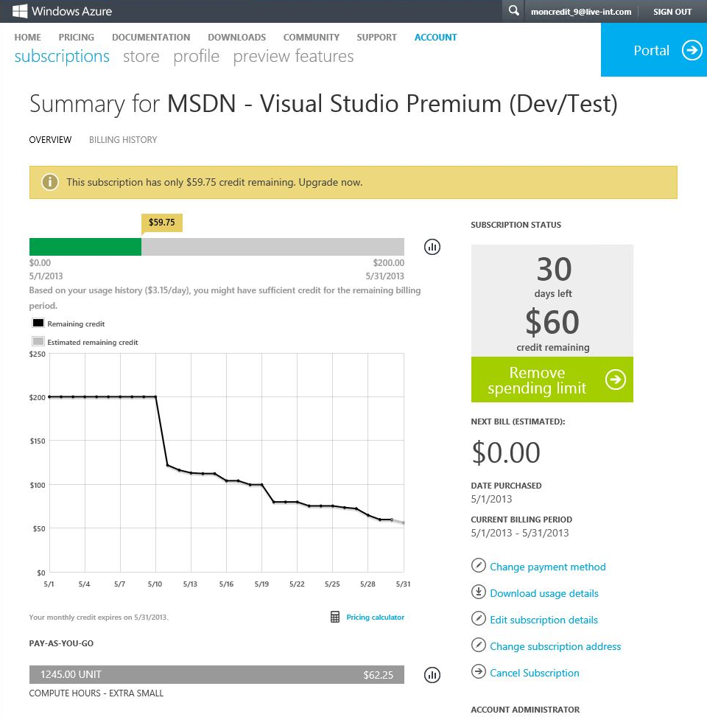
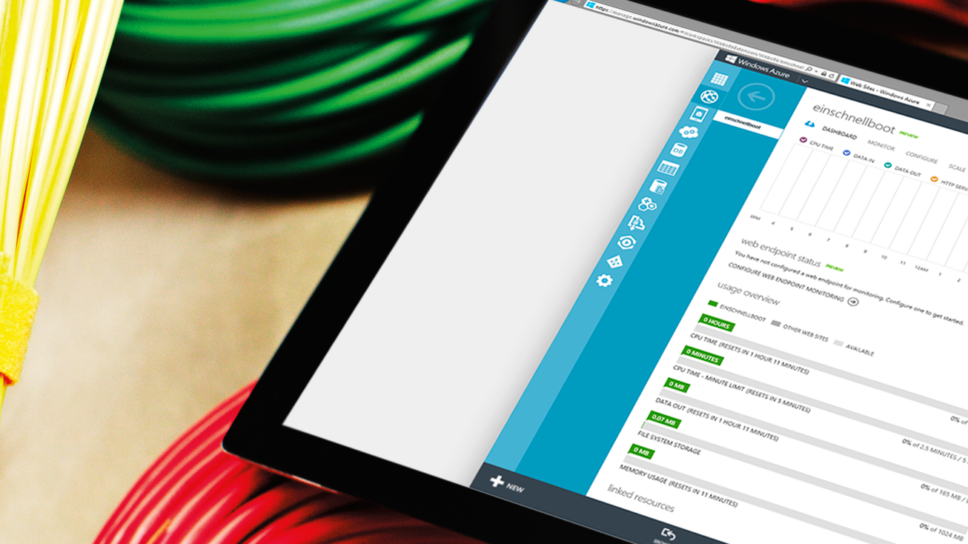
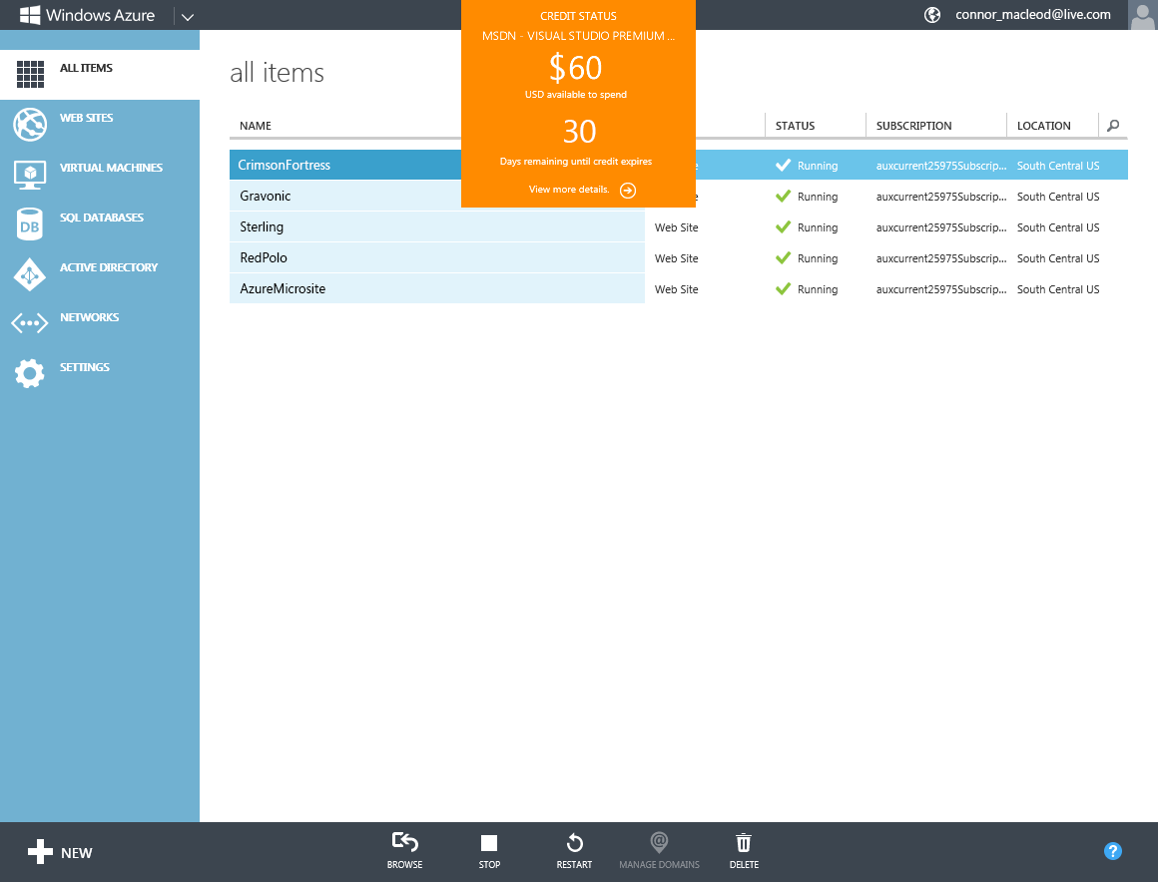
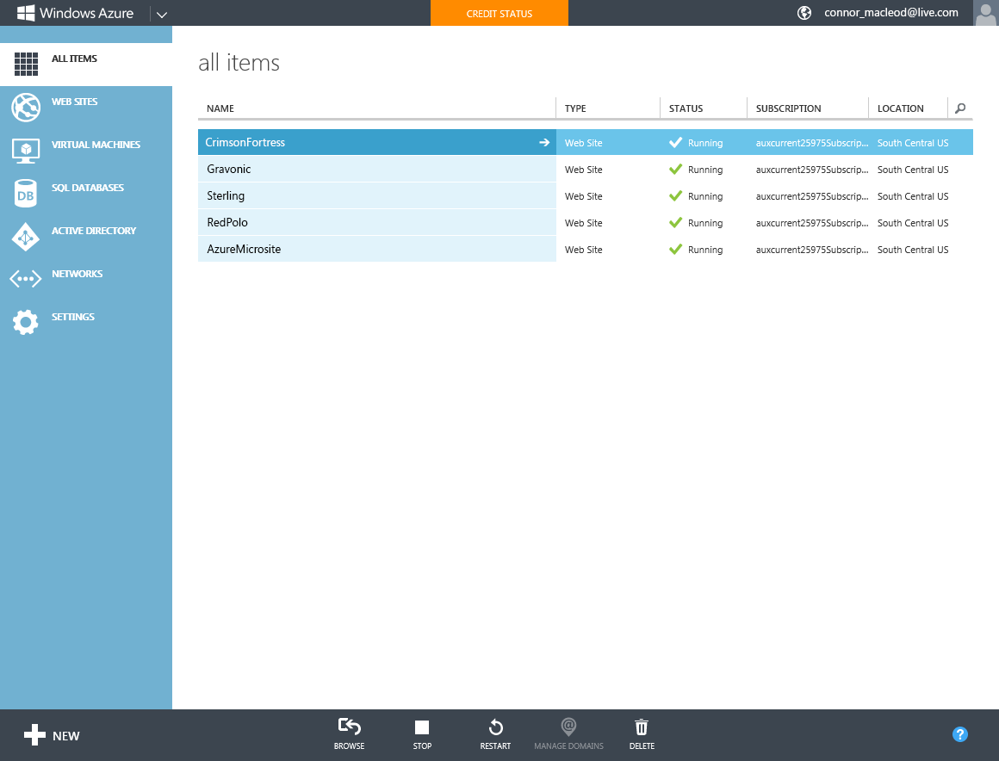

Slide 28
focus on apps, not infrastructure

Slide 29













application building blocks
HDInsight
SQL DB
Storage
Traffic Mgr
Cloud services
Cache
CDN
Active Directory
Web Sites
Mobile
media
Service Bus
BizTalk

Slide 30

SQL Database
Relational SQL Server Engine in the Cloud
Clustered for high availability
Fully Managed Service

Slide 31
SQL Database

Slide 32

Web Sites
Build with ASP.NET, Node.js or PHP
Deploy in seconds with FTP, Git or TFS
Easily scale up as demand grows

Slide 33
Web Sites

Slide 34
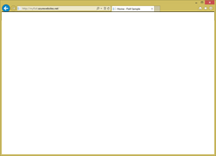
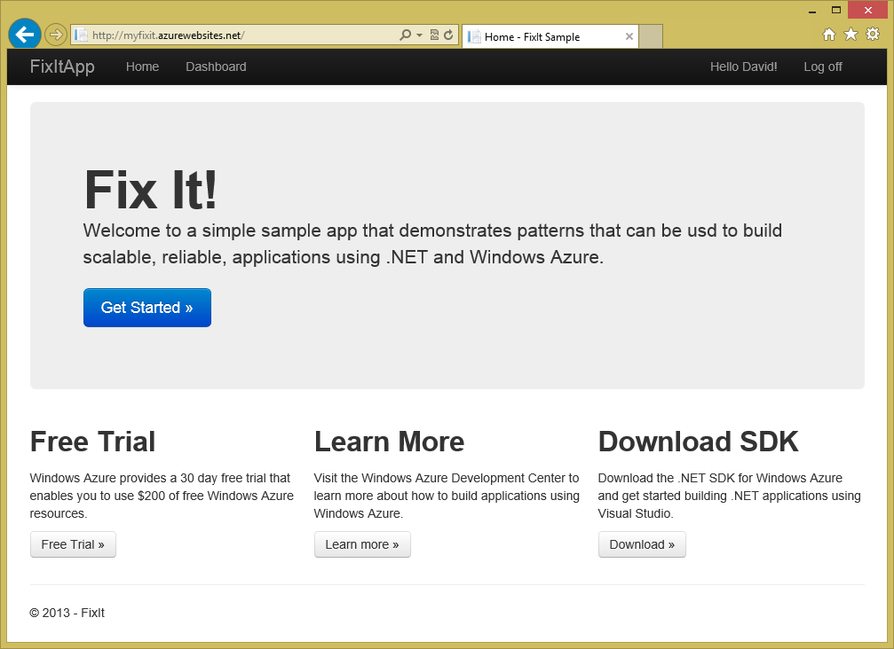
Windows Azure Web Site Service
Reserved Instance
Virtual Machine with
IIS already setup
(1 of 2)
Load Balancer
(1 of n)
Reserved Instance
Virtual Machine with
IIS already setup
(1 of n…)
Server Failure….
Reserved Instance
Virtual Machine with
IIS already setup
(2 of 2)
Load Balancer
(2 of n)
Reserved Instance
Virtual Machine with
IIS already setup
(2 of n…)
Dev tool or
Automation Script
Deployment Service
(FTP, WebDeploy, GIT, TFS, etc)
Reserved Instance
Virtual Machine with
IIS already setup
(2 of 2)

Slide 35
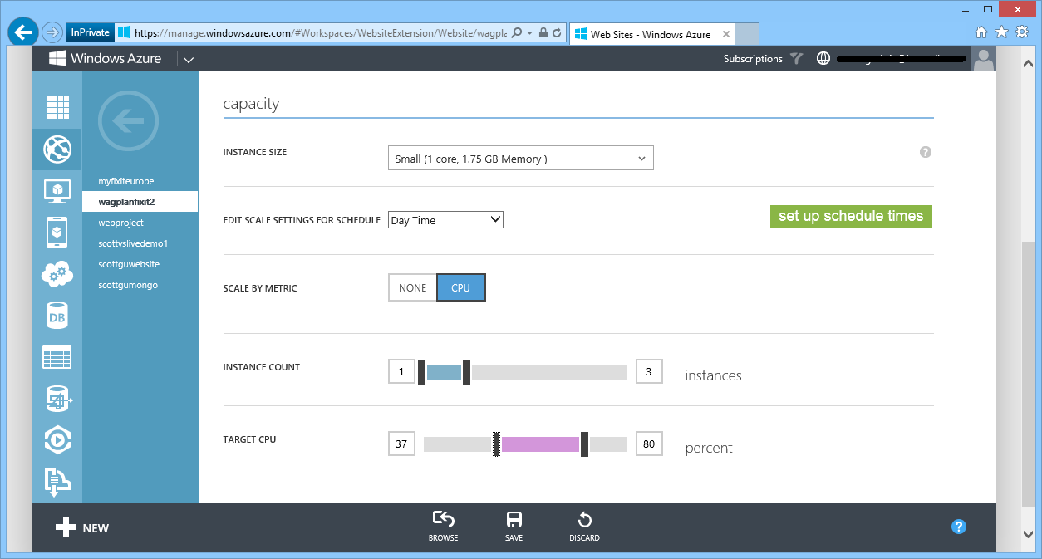
AutoScale – Built-into Windows Azure
AutoScale based on real usage
CPU % thresholds
Queue Depth
Supports schedule times

Slide 36
AutoScale

Slide 37
Dev/Ops Workflow
Develop
Repeatable
Reliable
Predictable
Low Cycle Time
Learn
Deploy
Operate

Slide 38
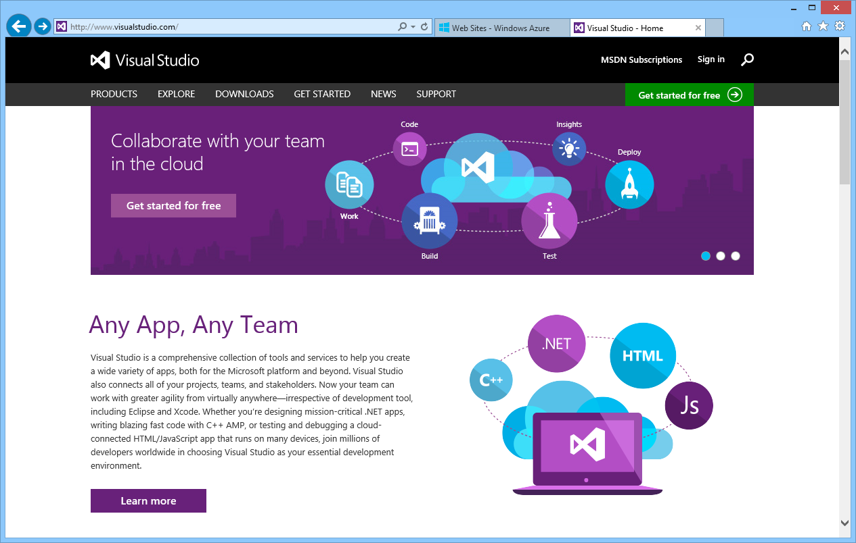
Visual Studio Online
TFS and Git support
Elastic Build Service
Continuous Integration
Continuous Delivery
Load Testing Support
Team Room Collaboration
Agile Project Management

Slide 39
Continuous Deployment

Slide 40

Running a Live Site Service

Slide 41
Running without Insight / Telemetry

Slide 42
Logging and Telemetry

Slide 43

Storage
Highly scalable, durable, available storage system
Blobs can be exposed over http (JSON + CORS)
Optionally enable client apps short term access
Import / Export Service with Physical Drives

Slide 44

Active Directory
Active Directory in the Cloud
Integrate with on-premises Active Directory
Enable single sign-on within your apps
Supports SAML, WS-Fed, and OAuth 2.0

Slide 45

3rd party apps
Windows Azure
Your app in Azure
Windows Azure Active Directory
Windows Server Active Directory

Slide 46
Windows Azure Active Directory

Slide 47
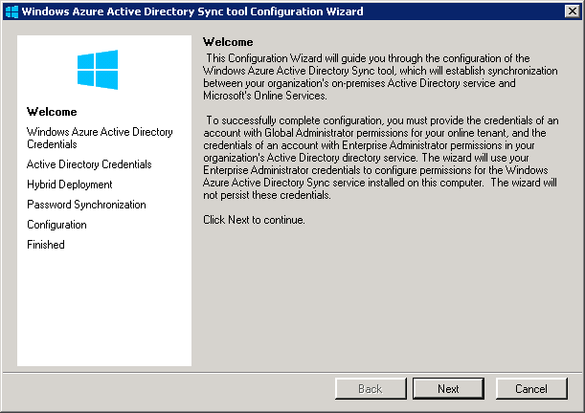
Config wizard automatically launches

Slide 48
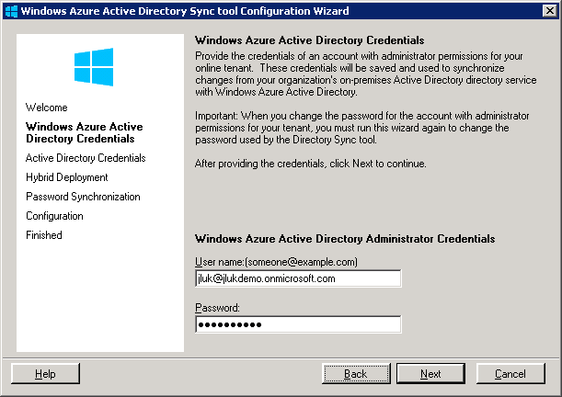
Enter Windows Azure AD Credentials

Slide 49
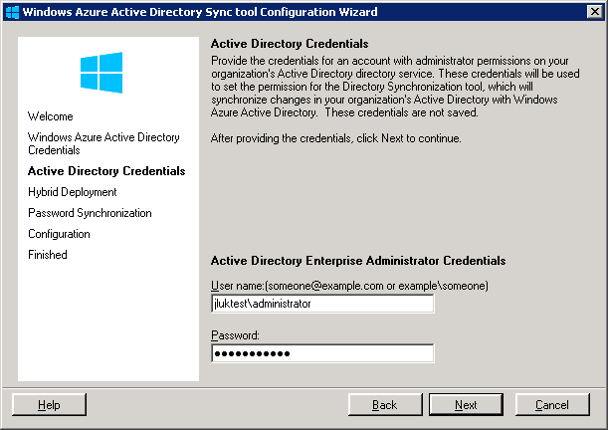
Enter Windows Server AD Credentials

Slide 50
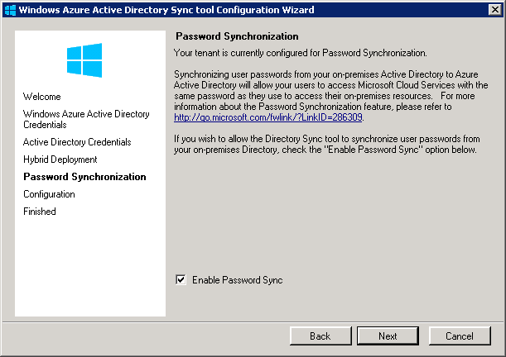
Enable Hashed Password Sync

Slide 51
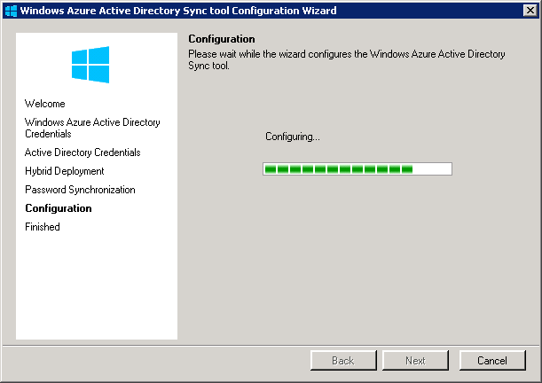
Almost done

Slide 52
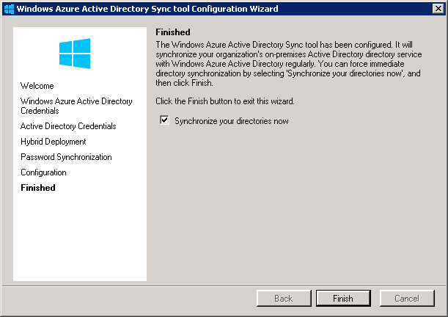
Finished – Sync will start automatically
No need to install on multiple DC’s. No reboot required!

Slide 53
Windows Azure Active Directory

Slide 54
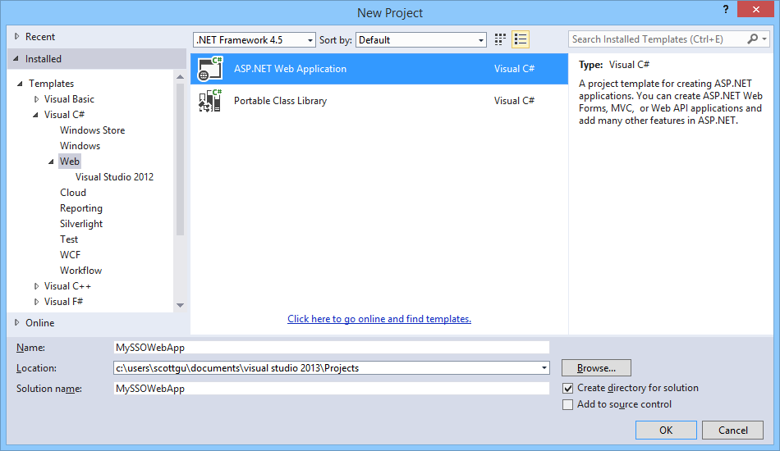
Enable SSO with Azure AD and ASP.NET

Slide 55
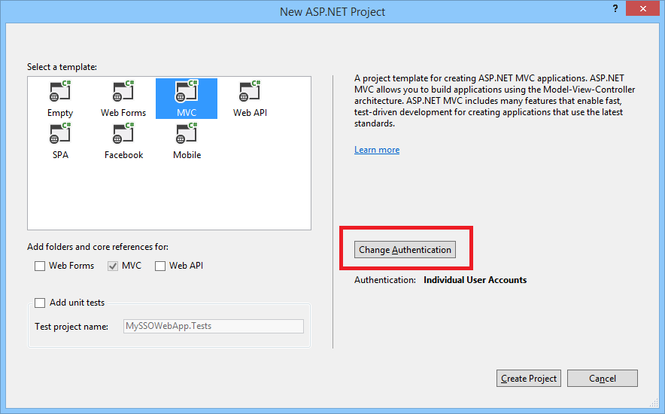
Enable SSO with Azure AD and ASP.NET

Slide 56
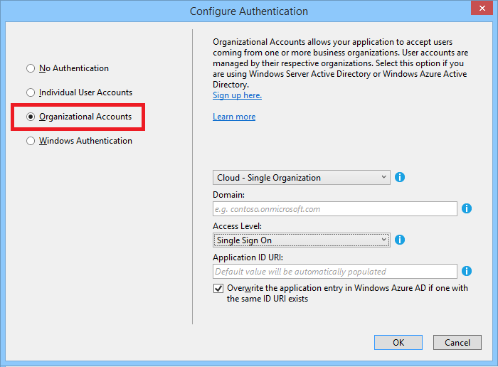
Enable SSO with Azure AD and ASP.NET

Slide 57
application building blocks
HDInsight
SQL DB
Storage
Traffic Mgr
Cloud services
Cache
CDN
Active Directory
Web Sites
Mobile
media
Service Bus
BizTalk

Slide 58
Windows Azure
Move Faster
Save Money
Hybrid Consistency
$

Slide 59

http://friday.azure.com

Slide 60

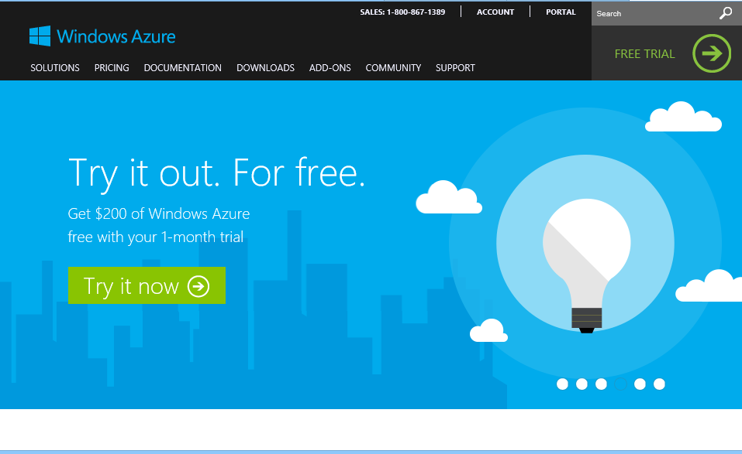
start now.
http://WindowsAzure.com

